Slide 1
PEOPLE as RESOURCES by Cynthia Maxwell Curtin, Esq.
Vestry Day
June 3, 2017
C: 315-530-8745
ccurtin@curtinlawpc.com

Slide 2
Introduction
How should you treat employees when you are a leader in a church?
What questions should guide your decisions?
What legal principles apply?
What are the benefits of a good work environment?

Slide 3
How should you treat employees?
Think:
Do I (or we, as the Church) have the right to do this?
Is it the right thing to do?
If yes to both 1 and 2, how do I/we do it in the right way?
As a member of the clergy or of the vestry, you are seen as a leader.
This carries authority and respect.
Do not betray that trust.
Because we are human, to honor that trust, we need to think before we speak or act.

Slide 4
Hiring an employee
Think through what you need and what you want.
Make sure you know the basics of what is needed—finance skills? People skills—with children? teens? young adults? middle age people? seniors? Audio/technical skills? Computer skills? Crisis management skills? Writing skills?
Think beyond what the prior person did. What else do you want the employee to do? And when? How?
Rectors and vestry should work together on this process.
Write, review, revise and then review and revise again a thorough and accurate job description.
Because of the Americans with Disabilities Act (as amended), make sure your list of essential functions is complete.
Articulate the intangible. For example, if you want the person to have good computer skills, describe what you mean—fast, creative, transcription, excel, Power point?
Carefully describe any confidentiality expectations of the position.
Make sure that the vestry is in accord regarding the final job description.

Slide 5
Hiring an employee
Use a myriad of avenues to seek applicants and for most positions, you will use social media including Linkedin and Facebook; the Church’s website and word of mouth. Target additional advertising consistent with the position (e.g., if it a music position, contact colleges with a music program).
Obtain from applicants at least a written application, a resume, a cover letter, a list of at least three people who you can contact as references and then do so!
Develop some standard questions for the applicants.
Have a diverse group of people interview the candidate.

Slide 6
Hiring an employee
Remind all people involved in the process to not ask questions that are illegal or even rude. For example, do not ask:
Are you planning on having children?
How are you going to take care of all of your kids if you are working here?
Given your disability, how can you possibly do this job?
You can ask if the person will need any accommodation to do the job if the applicant has voluntarily disclosed having a disability of if the person has an obvious disability.
I heard that you have kids—you are married right?
When you referenced a “partner”—you are talking about a spouse of the opposite sex—right?
Given your age, what are your plans for retirement?

Slide 7
Hiring an employee
Make the final decision to offer the position based on qualities you can articulate.
Do not base the decision on a good old boy’s or good old girl’s network.
Offer compensation based on the job and the market—not on what you think the person will accept.

Slide 8
Working together
Administrative Exemptions, which apply to positions where the duties are related to management of the company’s general business operations
Professional Exemptions, which apply to positions where the duties fall into on of four basic categories: learned professional, creative professional, teacher or computer employee
Executive Exemptions, which apply to positions where the duties are related to management of the enterprise and of at least two employees
Make sure there is an understanding about the basics-- work hours, attendance and performance.
Do not engage in any conduct or make any statements that implicate any protected category—age, race, national origin, sexual orientation, sex, gender identity, marital status, ancestry, color, disability, veteran status.
Comply with wage and hour laws.
To be exempt, the employee must meet the salary test and duties test. The salary test (as of December 31, 2016) is $727.50 per week ($37,830 annually)
The duties test requires that the person’s duties fit an exemption. The most common job duty exemptions fit into three categories:

Slide 9
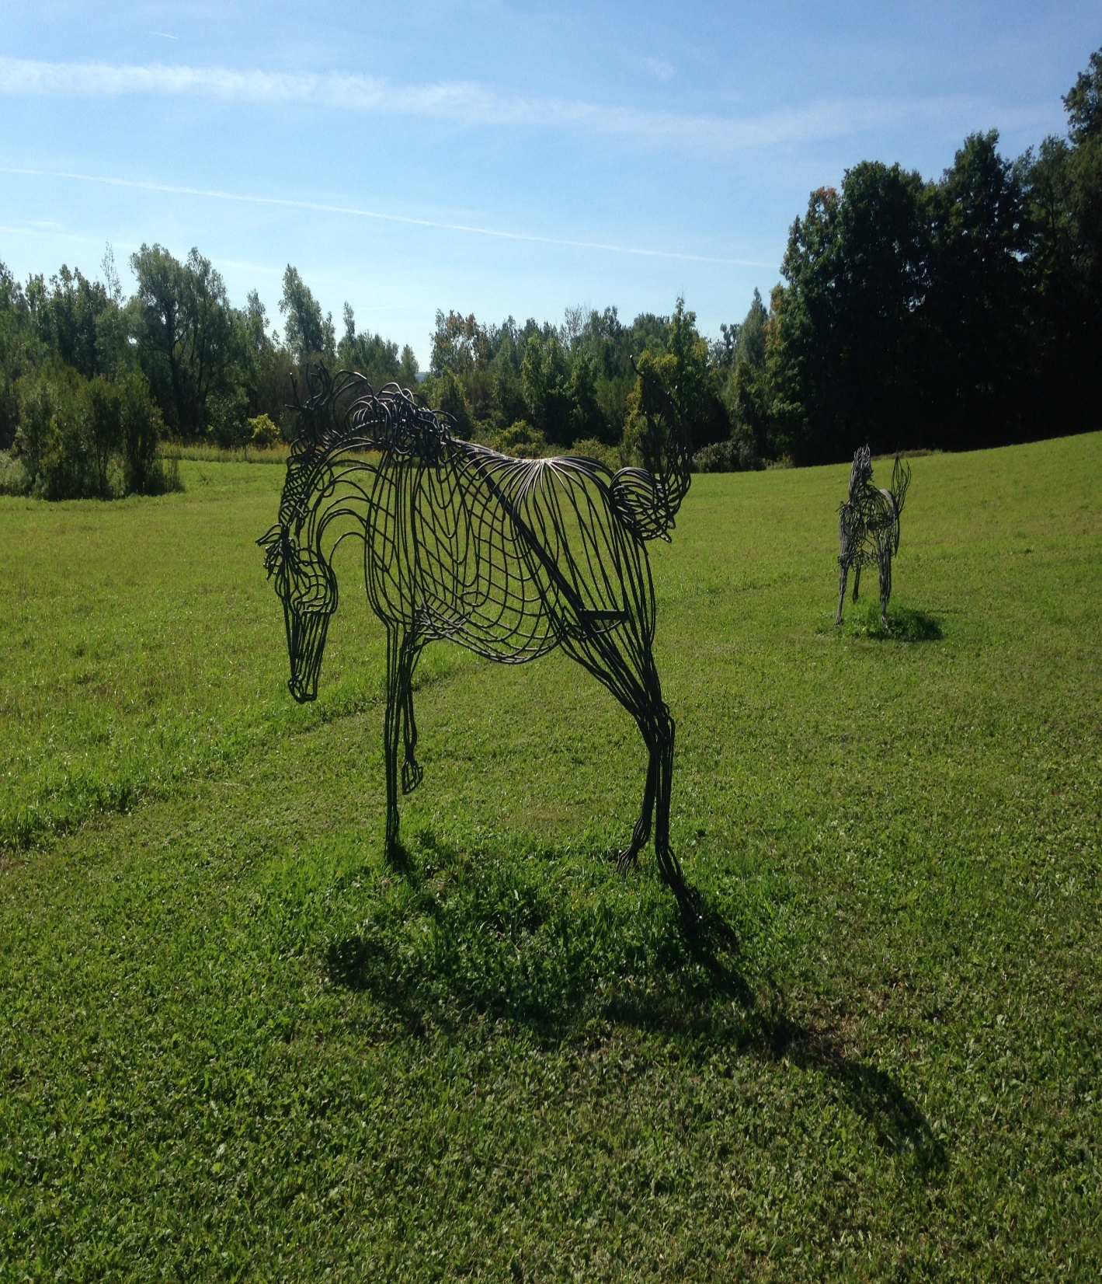
Working together
If the person is non-exempt, follow the law:
pay the minimum wage which in upstate New York is now $9.70 per hour;
pay overtime (time and ½) for hours worked over 40 hours in a week;
Make sure the employee takes at least a ½ hour lunch break around noon time (if the employee is working a typical day shift of). The employee must be relieved of all work responsibilities during the lunch break.

Slide 10
Working Together—is it the right thing to do and doing it right.
Treat the person as a member of the team (not as a servant).
Talk to the employee about her or his goals. It is not all about you.
Be human but not the employee’s best friend.
Laugh and share.
Admit when you are wrong.
Be patient and gracious.
Be mindful that you represent multiple roles to the employee: the leader, a Christian, an Episcopalian.
Role model the behaviors you seek in the employee.

Slide 11
Working Together—is it the right thing to do and doing it right.
Performance Reviews—a growth opportunity
Take the process seriously and take it equally seriously for all employees.
Base it on the job description
Include a self-assessment grounded in the job description and the goals set in prior performance review.
Include an opportunity for the employee to describe his or her goals.
Include an opportunity for the employee to suggest changes to the job description.
Ensure that your documented review includes positive feedback, concerns/areas for improvements and goals.
Document the goals and changes in the job description to which there is agreement with the employee’s signature.

Slide 12
Working Together—is it the right thing to do and doing it right.
On-going performance concerns:
Problems don’t disappear on their own.
Be honest but calm.
Review the issues in private.
Don’t play favorites—hold everyone to the same standards.
Ask the employee to suggest solutions.
Document the conversations, the concerns and the employee’s commitment to improve with the employee’s signature.

Slide 13
Parting ways as a sweet sorrow
Employees will leave and generally of their own accord if you have been clear and yet kind.
Employees will leave even when you do not want them to leave but be happy for them.
If an employee needs to leave and hasn’t or won’t leave on her or his own:
Ensure that you have Vestry agreement to the termination.
When in doubt about a termination, reach out—call the Diocese; consult counsel.
Be honest but calm.
Review the issues in private.
Refer to the documentation discussed above.
Don’t play favorites—hold everyone to the same standards.
Be open to accepting a retirement or a resignation.

Slide 14
Parting ways done poorly
Some people think because New York is an at will state, they can terminate an employee without a care—but:
An angry, disgruntled ex-employee can wreak havoc on social media.
She or he can claim that the termination violated the no discrimination laws (as just about everyone fits in some protected category or another).
The fired employee can undermine your efforts in the community just by sharing his or her perspective on being treated unfairly.
The fired employee can find a friend or two on the vestry and create divisions within the church.
The fired employee can tell her or his friends who go to the church how awful it was to work there and then those friends decide to change churches.

Slide 15
Conclusion
Remember—
Do we have the right to do this?
Is it the right thing to do?
And if yes to 1 and 2, how do we do it in the right way?

Slide 16
Conclusion
Inspire people. Seize the Church’s mission and goals. Make them yours. Build a common purpose. Weld individual efforts towards common goals.
Develop people. Coach them, mentor them, teach them, reward improvement and guide towards improvement.
Be a catalyst for positive change. Recognize what changes will be useful. Even if a change is difficult, be a champion for necessary change and be creative about ways to mitigate any hardships resulting from the change.
Be a team player by being collegial, supportive and encouraging of others with ample praise and credit to others.
Know what to reward and how to reward people. Reward results.
Work with others to avoid conflict and if the conflict is unavoidable, to manage conflict.

Slide 17
Conclusion– Doris Kearns Goodwin’s Ten Lessons for Leaders:
Lyndon Johnson, John Kennedy, and Franklin Roosevelt were three very different people and presidents. But their stories offer at least ten useful lessons for leaders of today's organizations.
Timing is (almost) everything. Knowing when to introduce an initiative, when to go before one's constituents -- and when to hold off -- is a crucial skill.
Anything is possible if you share the glory. Giving others a chance to claim credit is an easy, and effective, way to get results.
Trust, once broken, is seldom restored. It is the most fragile yet essential attribute of leadership. No leader can afford to take his word lightly.
Leadership is about building connections. Effective leaders make people feel they have a stake in common problems.
Leaders learn from their mistakes. To succeed, leaders must acknowledge and understand and improve on their shortcomings.
Confidence -- not just in oneself -- counts. Most leaders are self-confident, sometimes to a fault; the real gift is the ability to extend faith in oneself to others. That means actually believing in their gifts.
Effective partnerships require devotion to one's partners. Attention to the needs of the remote plant or institution pays off with energetic commitment.
Renewal comes from many sources. Leaders must know themselves and find their own sources of strength.
Leaders must be talent brokers. The ability to identify, recruit, and effectively manage the best and brightest people -- including people unlike oneself -- is itself a key talent.
Language is one's most powerful tool. Without the ability to communicate, leaders can possess all the other attributes and still fail to have an impact.

Slide 18
Conclusion
Keep learning about yourself—your strengths; your passions; your weaknesses; the gaps between your ideals and your real.
Keep learning about others—their strengths, passions and goals.
Keep working on developing your skills at managing yourself so that you can effectively lead and engage others.
Be the key to creating an environment in which people thrive—joyous and spirit filled.

